Slide 1
Evaluation Techniques

Slide 2
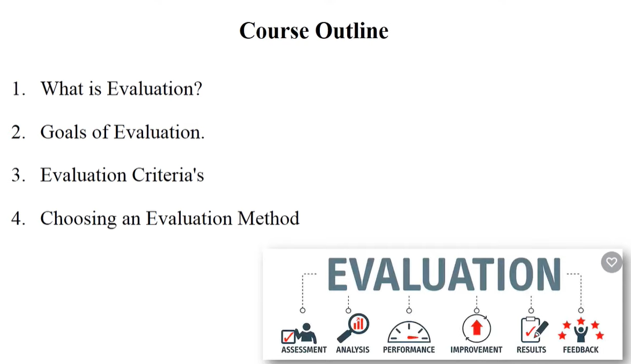

Slide 3
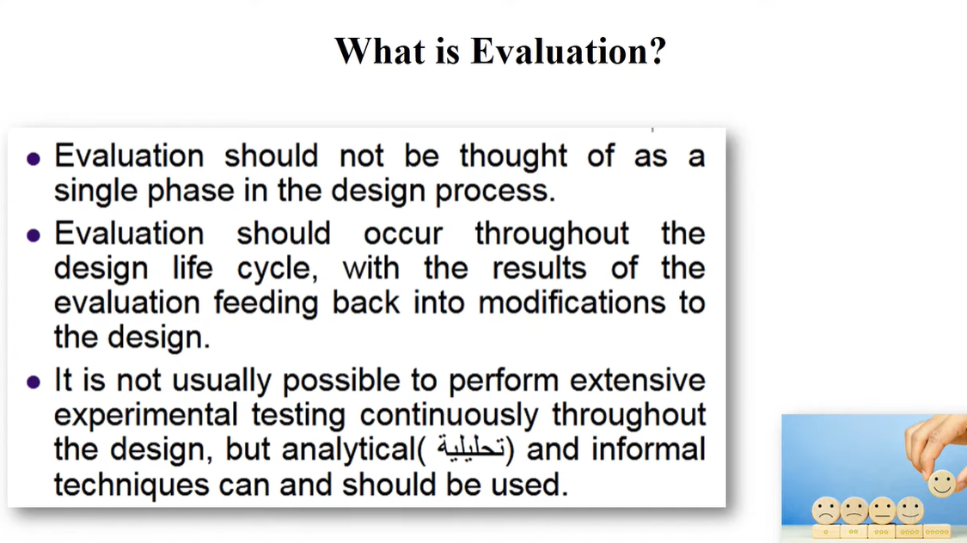

Slide 4
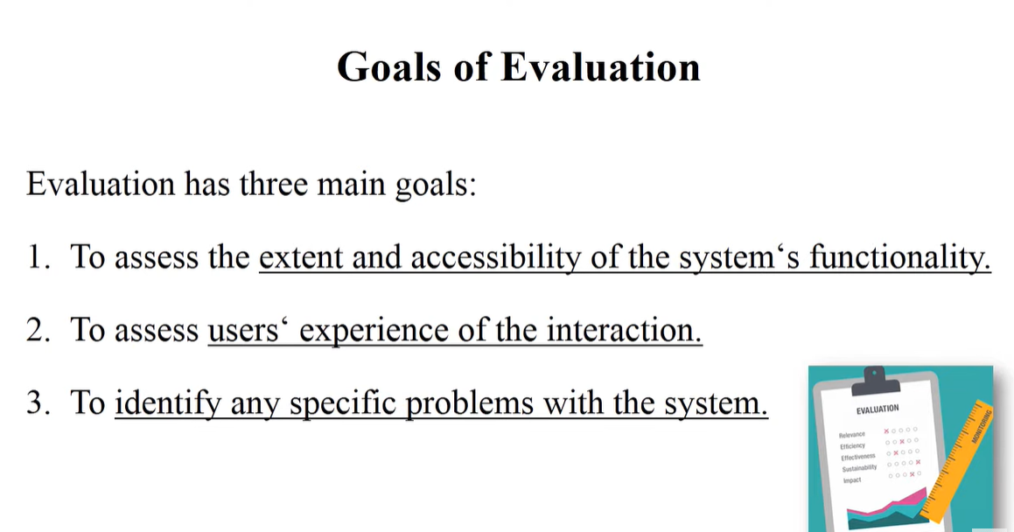

Slide 5
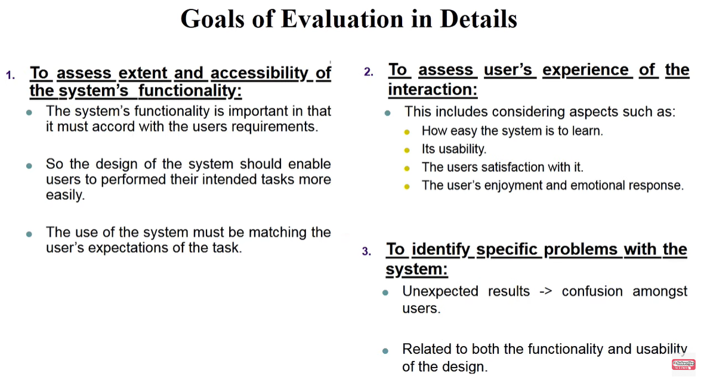

Slide 6
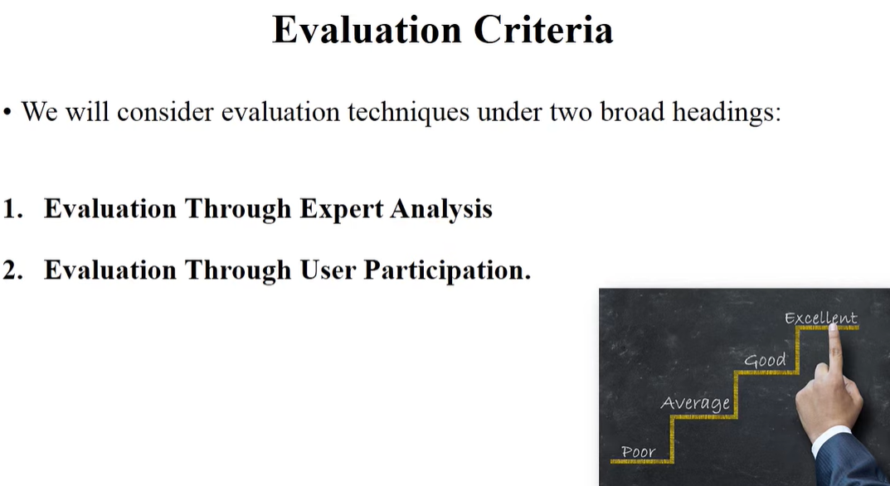

Slide 7
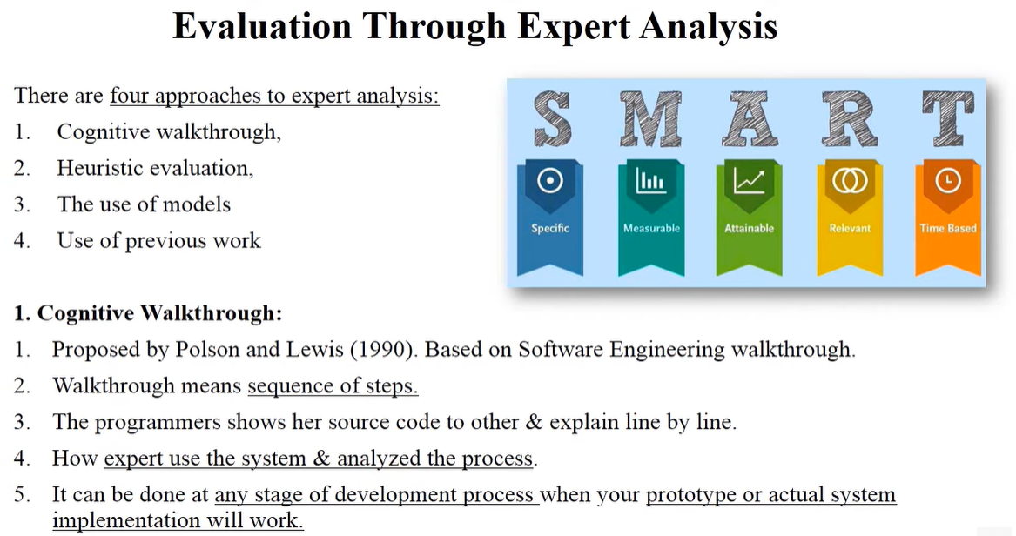

Slide 8
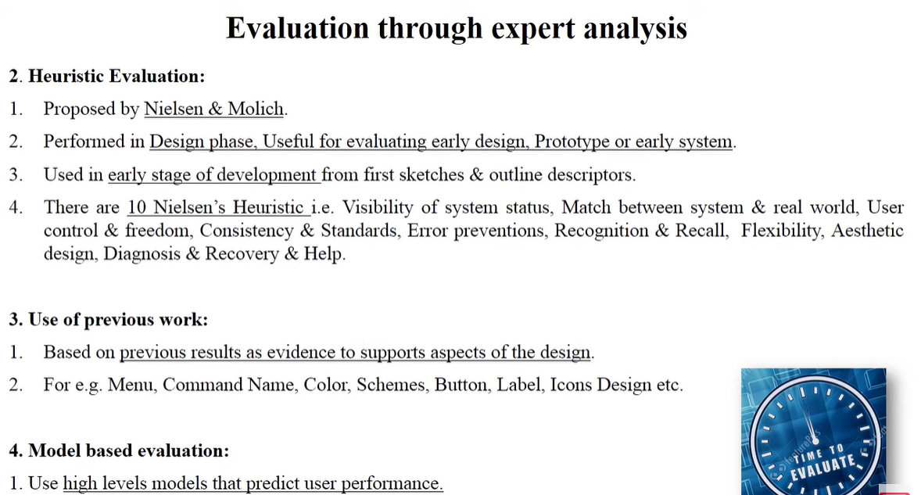

Slide 9
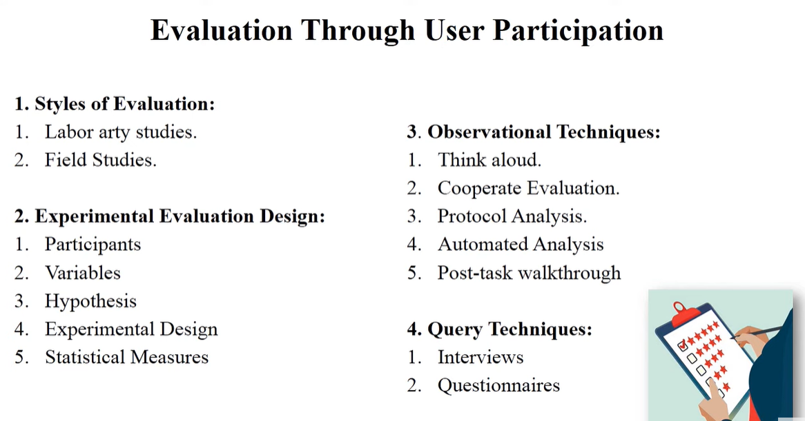

Slide 10
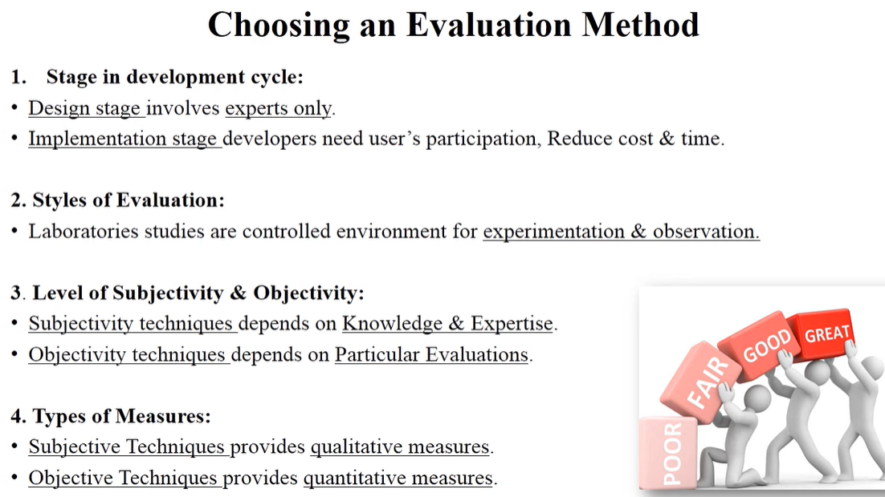

Slide 11
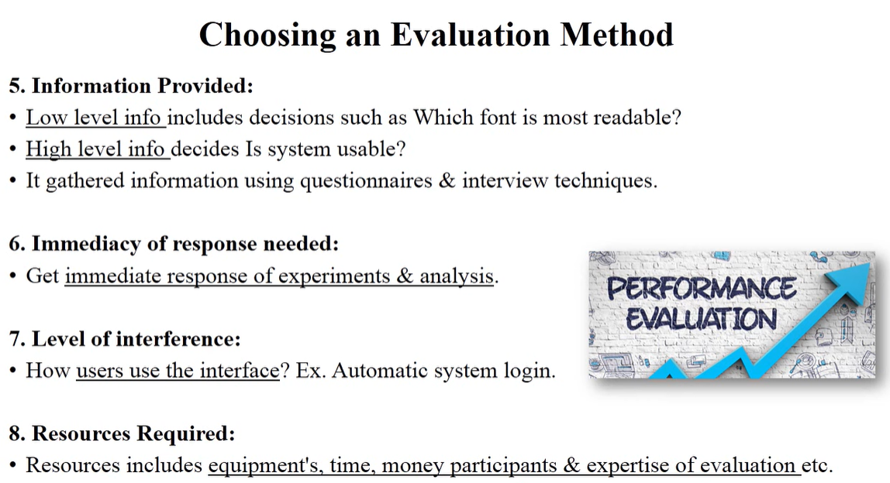

Slide 12
Jakob Nielsen's 10 Heuristics
Jakob Nielsen's 10 Heuristics for User Interface Design, which are a set of general principles for usability and UX evaluation. These heuristics help identify usability issues in interfaces without requiring user testing. Here they are:
1. Visibility of System Status
Keep users informed about what’s happening through feedback and status updates.
Example: A progress bar during file upload.
2. Match Between System and the Real World
Use familiar concepts, language, and metaphors that users understand.
Example: A trash bin icon for deleted files.
3. User Control and Freedom
Users should be able to undo actions or exit processes easily.
Example: A cancel button on a form or an undo option in text editing.
4. Consistency and Standards
Stick to common conventions and avoid making users guess.
Example: Using standard icons like a gear for settings.

Slide 13
Jakob Nielsen's 10 Heuristics
5. Error Prevention
Reduce the likelihood of user errors through clear instructions and confirmations.
Example: A confirmation message before deleting a file.
6. Recognition Rather Than Recall
Minimize the need for users to remember information by making options visible.
Example: Autofill suggestions in search bars.
7. Flexibility and Efficiency of Use
Allow both beginners and advanced users to navigate efficiently (e.g., shortcuts).
Example: Keyboard shortcuts in software like Ctrl + C for copy.
8. Aesthetic and Minimalist Design
Avoid unnecessary clutter and keep the interface simple.
Example: Clean dashboard designs with only essential information.

Slide 14
Jakob Nielsen's 10 Heuristics
9. Help Users Recognize, Diagnose, and Recover from Errors
Use clear error messages and suggest solutions.
Example: "Incorrect password" instead of a vague "Login failed."
10. Help and Documentation
Provide accessible and easy-to-follow help documentation when needed.
Example: A guided tour for new users or an FAQ section.
These heuristics are widely used in UX design and usability testing to evaluate the effectiveness of digital products.

